Slide 1




An Introduction to Foundation Models for Science
Tutorial 3: Uncertainty quantification

Slide 2
Before we begin
Open the notebook for this tutorial
Run the first 4 code cells (until the title Simple classifier)

Slide 3
Why uncertainty quantification?
How far are model predictions / generations from ground truth reality?
Sources of uncertainty:
  Inherent stochasticity of data generating process modeled (irreducible / aleatoric uncertainty)
  Model misspecification
  Finite training data
  ….
Decision making reasoning about uncertainty

Slide 4
Model confidence & calibration
Class probabilities, predict regression target + variance
Entropy
Needs to be calibrated
  Predicted probabilities match true empirical frequencies
Example
Data point | Model 1 |  |  |  | Model 2 |  |  |  | True Class
 | Class 1 | Class 2 | Class 3 | Class 4 | Class 1 | Class 2 | Class 3 | Class 4
1 | 0.90 | 0.04 | 0.02 | 0.02 | 0.33 | 0.28 | 0.24 | 0.15 | 2
2 | 0.01 | 0.01 | 0.95 | 0.03 | 0.13 | 0.19 | 0.41 | 0.27 | 3
3 | 0.04 | 0.03 | 0.02 | 0.91 | 0.26 | 0.22 | 0.20 | 0.32 | 4
4 | 0.02 | 0.02 | 0.93 | 0.03 | 0.19 | 0.17 | 0.36 | 0.28 | 3
5 | 0.05 | 0.02 | 0.89 | 0.04 | 0.22 | 0.27 | 0.29 | 0.23 | 2

Slide 5
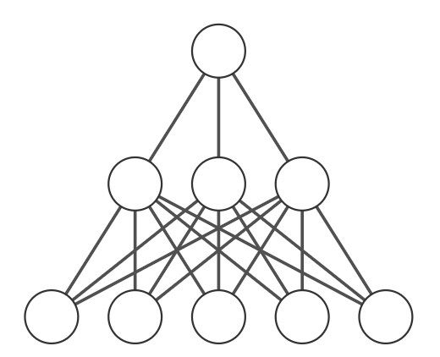
Ensembling, multiple inference
Deep ensembles
  Impractical to train ensemble of FMs
MC dropout
  Leave dropout on during inference, generate multiple inferences
  Variance in predictions due to random dropout quantifies model uncertainty
  Very easy to implement and use
Multiple predictions for a single input
Different random drop-out patterns for multiple predictions in inference
One input

Slide 6
Conformal prediction
Model-agnostic method that wraps around any predictor.
Theoretical coverage guarantees without assuming normality or calibration.
Simplest form: use calibration set to define the quantile of a conformity score (e.g. residuals, loss) that matches your desired confidence level, α
  ie
From calibration set
Predictor from train set
Ordered residuals in calibration set

Slide 7
Some UQ Resources
https://www.ibm.com/think/topics/uncertainty-quantification
A survey of uncertainty in deep neural networks
ICLR 2025 Workshop: Quantify Uncertainty and Hallucination in Foundation Models
Aleatoric and epistemic uncertainty: https://arxiv.org/pdf/1910.09457
Calibration and temperature scaling: https://geoffpleiss.com/blog/nn_calibration.html
MC dropout: https://arxiv.org/pdf/1506.02142
Heteroscedastic model with MC dropout: https://arxiv.org/pdf/1703.04977
Conformal prediction: https://www.stat.berkeley.edu/~ryantibs/statlearn-s23/lectures/conformal.pdf
Conformalized quantile regression: https://arxiv.org/pdf/1905.03222

Slide 8
Bio datasets on huggingface
Uniprot protein sequences: https://huggingface.co/datasets/damlab/uniprot
Protein sequence to structure: https://huggingface.co/datasets/lamm-mit/protein_secondary_structure_from_PDB
Protein function: https://huggingface.co/datasets/Protein-FN/Protein-FN
Enzyme binary classification: https://huggingface.co/datasets/graphs-datasets/PROTEINS
Proteingym: https://huggingface.co/datasets/ICML2022/ProteinGym
Protein binding: https://huggingface.co/datasets/ronig/protein_binding_sequences
cellXgene single cell datasets: https://cellxgene.cziscience.com/datasets
Gene coding sequence tasks: https://huggingface.co/datasets/InstaDeepAI/true-cds-protein-tasks

Slide 9
Some foundation models for bio
ESM-2 (protein): https://huggingface.co/facebook/esm2_t36_3B_UR50D
Prot_bert: https://huggingface.co/Rostlab/prot_bert
EVO-2 (DNA): https://huggingface.co/arcinstitute/evo2_40b
Biobert (biomedical LLM): https://huggingface.co/dmis-lab/biobert-v1.1
scGPT (sc gene expression): https://huggingface.co/tdc/scGPT
Geneformer (gene expression): https://huggingface.co/ctheodoris/Geneformer

